Slide 1

GOVERNMENT COLLEGE OF ENGINEERING BARGUR (AUTONOMOUS)
PROJECT TITLE: BIG DATA ANALYSIS WITH IBM CLOUD DATABASES
Team Members:
INDHUPRIYA S.
KAVIYAPRIYA K.
LAVANYA T.
PRATIBHA T.
SAMISHA V.

Slide 2
PROBLEM STATEMENT:
“Today's organizations generate vast amounts of data from various sources, including customer interactions, sensors, and social media. Analyzing this data is crucial for making informed business decisions, but traditional data analysis tools are often inadequate to handle the volume, variety, and velocity of big data. Therefore, the problem at hand is to develop a robust big data analysis solution that can efficiently process and extract valuable insights from large and complex datasets, enabling organizations to gain a competitive edge, improve decision-making, and drive innovation.”

Slide 3
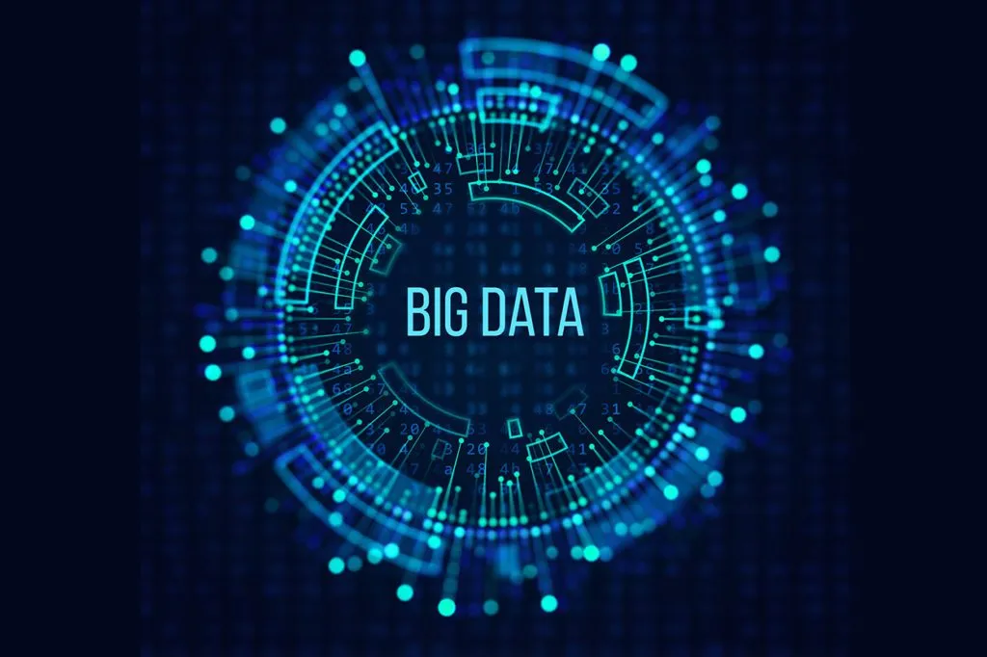
BIG DATA:
Big data analysis, often simply referred to as "big data analytics," is the process of examining and extracting valuable insights, patterns, trends, and information from large and complex datasets that are too massive to be effectively handled by traditional data processing and analysis tools.
It involves the use of specialized software and technologies to manage, process, and interpret these vast volumes of data.

Slide 4
BIG DATA ANALYSIS IN VARIOUS FIELDS:
Detect patterns and trends that were previously hidden.Predict future events or outcomes through predictive analytics.
Gain a deeper understanding of customer behavior and preferences.Optimize business operations and supply chain management.
Enhance cybersecurity by identifying anomalies and threats.
Facilitate scientific research by processing and analyzing large datasets.
The ultimate goal is to transform vast amounts of data into actionable insights that can drive informed decision-making and improve various aspects of business and research.

Slide 5
WORKING
Data Collection: The process starts with the collection of data from various sources. This data can come from sensors, social media, websites, devices, databases, logs, and more. The data is often stored in distributed storage systems like Hadoop HDFS or cloud-based storage solutions.
Data Ingestion: After collecting data, it needs to be ingested into the big data platform. This involves transferring data into a data processing environment where it can be analyzed. Data can be ingested in real-time or batch mode, depending on the use case.
Data Storage: Data is stored in a distributed manner using databases like NoSQL databases (e.g., HBase, Cassandra, MongoDB) or traditional relational databases (e.g., SQL databases). Data is organized and indexed for efficient retrieval.

Slide 6
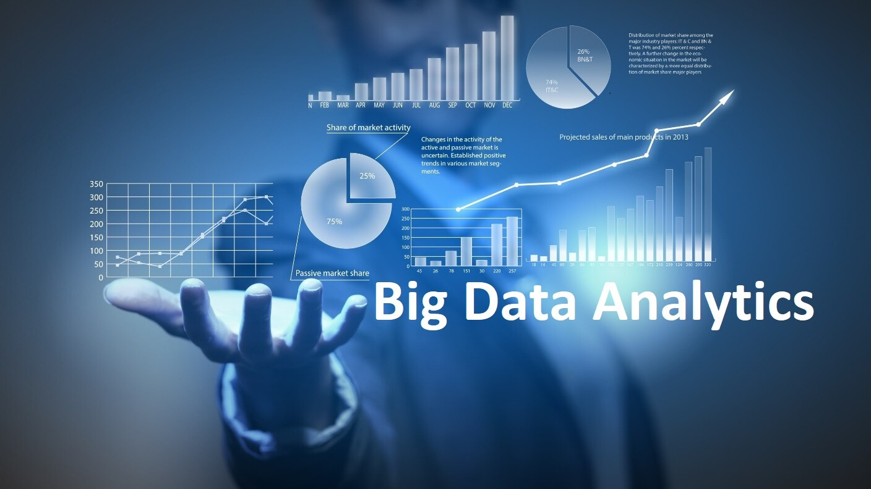
DATA PROCESSING AND ANALYSIS:
In batch processing, data is analyzed in large chunks or batches. Technologies like Hadoop MapReduce and Apache Spark are commonly used for batch processing.
Real-time Processing: In real-time or streaming analysis, data is processed as it arrives. Technologies like Apache Kafka and Apache Flink are used for real-time processing.

Slide 7
Data Visualization: The results of the analysis are often presented through data visualizations and dashboards. Tools like Tableau, Power BI, or custom-built dashboards can be used to present the findings in a user-friendly manner.
Insights and Decision-Making: The final stage involves interpreting the results, extracting valuable insights, and using these insights to inform decision-making, whether in business, research, or other fields.
Scalability and Performance: Big data systems are designed to scale horizontally, allowing them to handle vast amounts of data and computations efficiently. This often involves the use of clusters and distributed computing.

Slide 8

Insights and Decision-Making: The final stage involves interpreting the results, extracting valuable insights, and using these insights to inform decision-making, whether in business,
research, or other fields.
Scalability and Performance: Big data systems
are designed to scale horizontally, allowing
them to handle vast amounts of data and
computations efficiently. This often involves
the use of clusters and distributed computing.
Data Security and Governance: Data security
and governance are crucial aspects of big data
analysis. Access controls, encryption, and compliance with data regulations are essential.

Slide 9
Data Preparation:
# Import necessary libraries import pandas as pd import numpy as np
# Load the dataset data = pd.read_csv('rainfall_india_1901-2015.csv’)
# Perform data preprocessing (e.g., handling missing values, feature engineering)
# ... # Split the dataset into training and testing sets from sklearn.model_selection
import train_test_split train_data, test_data = train_test_split(data, test_size=0.2, random_state=42)

Slide 10
Setup:
Install Apache Spark, set up your cluster, and configure your environment.
Data Ingestion:
Load your big data into Spark. You can use data sources like HDFS, cloud storage, or databases.
Data Transformation:
Preprocess and clean the data as needed. You can use Spark's data manipulation functions.

Slide 11
Data Analysis:
Use Spark's APIs to run various analytical tasks. For example, you can perform SQL queries, machine learning, graph analysis, or any custom data processing.
Visualization:
Depending on your needs, you might want to visualize the results. You can use libraries like Matplotlib or integrate with tools like Tableau.
Scaling:
Big data often requires horizontal scaling. You can add more resources (nodes) to your Spark cluster to handle larger datasets

Slide 12
PYTHON CODE:
# Import necessary librariesimport pandas as pdimport numpy as npimport matplotlib.pyplot as plt
# Load the big datadata = pd.read_csv("your_data.csv")
# Explore the dataprint(data.head()) # Display the first few rowsprint(data.info())
# Get information about the datasetprint(data.describe())
# Summary statistics
# Data preprocessing (e.g., handling missing values)data = data.dropna()
# Remove rows with missing values

Slide 13
# Data analysis
# You can perform various analyses like data visualization, statistical tests, and more.
# Example: Plot a histogramplt.hist(data['column_name'], bins=20)plt.xlabel('X-axis label')plt.ylabel('Y-axis label')plt.title('Histogram of Column Name')plt.show()
# Machine learning or statistical analysis
# Depending on your goals, you can apply machine learning models or statistical tests.
# Example: Linear regressionfrom sklearn.linear_model import LinearRegressionmodel = LinearRegression()X = data[['independent_var']]y = data['dependent_var']model.fit(X, y)

Slide 14
# Interpret and visualize the resultsplt.scatter(X, y, color='b’)
plt.plot(X, model.
predict(X), color='r’)
plt.xlabel('Independent Variable’)
plt.ylabel('Dependent Variable’)
plt.title('Linear Regression’)

Slide 15
plt.show()
# Final data insights and conclusions
# Summarize your findings, generate reports, or make data-driven decisions based on your analysis.
# Save the results if needed
# You can save data or model outputs for future reference.

Slide 16
Training and Validation
# Train and validate the models
# ...
# Evaluate model performance (e.g., Mean Absolute Error, Root Mean Squared Error)
# ...

